Slide 1

Westminster Shorter Catechism
Questions 18 - 20
February 28, 2021
Calvary OPC, La Mirada, CA

Slide 2
Homework! :-)
Memorize the following verses:
1John 3:4
James 4:17
Romans 5:12
Genesis 2:7
Hebrews 4:12
github.com/csmatyi/calvary_sunday_school

Slide 3
CORRECTION: Biblical counseling
Problem: sinful behavior patterns are at the root of every problem
It may also be the root of physical problems as well
The goal of Biblical (nouthetic) counseling is to bring people back into the original state Adam was in
Since evolution-based secular psychology does not have a concept of sin, it is bound to fail each time
We must be more and more like Christ, who knew no sin
Be imitators of me, just as I also am of Christ. (1Corinthians 11:1)
The goal is to biblically address sin issues in people's lives to affect personality/behavioral changes

Slide 4
Question #18
Q. Wherein consists the sinfulness of that estate whereinto man fell?
A. The sinfulness of that estate whereinto man fell consists in the guilt of Adam's first sin, the want of original righteousness, and the corruption of the whole nature, which is commonly called Original Sin, together with all actual transgressions which proceed from it.

Slide 5
What does the Bible say?
"And God saw that the wickedness of man was great in the earth, and that every imagination of the thoughts of his heart was only evil continually" (Genesis 6:5)
"For out of the heart proceed evil thoughts, murders, adulteries, fornications, thefts, false witness, blasphemies" (Matthew 15:19)

Slide 6
Total depravity
Man's sin is inward
It stems from our fallen nature, from our very heart
It is also great
Not minor sins, but open, flagrant rebellion against God's will
Sin is also continual
"Then the Lord saw that the wickedness of man was great in the earth, and that every intent of the thoughts of his heart was only evil continually." (Genesis 6:5)
"If we say that we have no sin, we deceive ourselves, and the truth is not in us." (1John 1:8)
Contra Wesleyan-Pentecostal perfectionism
It is also universal
All men are effected (Romans 3:10)

Slide 7
Corruption in extent or degree?
In extent: all faculties of man are affected
Heart, will, mind, soul, body, emotions, etc.
In degree: we are not as totally depraved as we may possibly be
There are some restraints
Only in hell will people become totally depraved, the way Satan is totally depraved

Slide 8
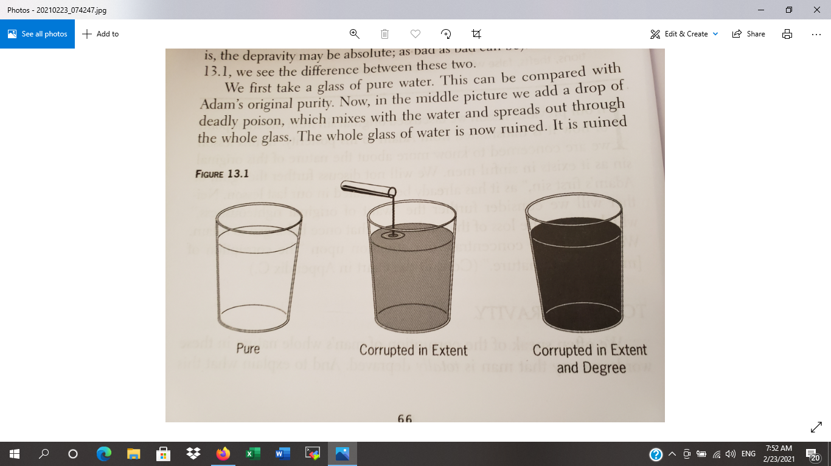

Slide 9
What restrains us from being even worse?
Our conscience reminds us of God's will
"who show the work of the law written in their hearts, their conscience also bearing witness, and between themselves their thoughts accusing or else excusing them" (Romans 2:15)
The civil government deters from doing evil
"For he is God’s minister to you for good. But if you do evil, be afraid; for he does not bear the sword in vain; for he is God’s minister, an avenger to execute wrath on him who practices evil." (Romans 13:1-5, v. 4)
The fear of death and judgement
"and release those who through fear of death were all their lifetime subject to bondage. " (Hebrews 2:15)
Influence of the church, family, education, and society

Slide 10

Freedom and ability
Man has the freedom to do anything he wants
You may go to the store if you want
You may apply to study at a college of your choice
You may even fly if you feel like it! :-D
Sinners may even do good
But, alas they do not have the ability to do so
They are unable by their nature
God also cannot sin by His nature

Slide 11
Freedom and ability
"There is none that doeth good, no, not one" (Romans 3:12)
"The imagination of man's heart is evil from his youth"
(Genesis 8:21)
"For the Lord seeth not as man seeth; for man looketh upon the outward appearance, but the Lord looketh upon the heart" (1Samual 16:7)
"Can the Ethiopian change his skin, or the leopard his spots?" (Jeremiah 13:23)

Slide 12
Question #19
Q. What is the misery of that estate whereinto man fell?
A. All mankind, by their fall, lost communion with God, are under His wrath and curse, and so made liable to all the miseries in this life, to death itself, and to the pains of hell forever.

Slide 13
What does the Bible say?
"Adam and his wife hid themselves from the presence of the Lord God." (Genesis 3:8)
"And were by nature the children of wrath..." (Ephesians 2:3)
"For the wages of sin is death..." (Romans 6:23)
"Then shall he also say unto them on the left hand, depart from me ye cursed, into everlasting fire, prepared for the devil and his angels" (Matthew 25:41)

Slide 14

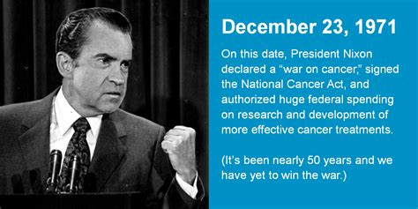

For the wrath of God is revealed from heaven against all ungodliness and unrighteousness of men, who suppress the truth in unrighteousness.
(Romans 1:18)

Slide 15
Vanitatum vanitas
"'Vanity of vanities,' says the Preacher; 'Vanity of vanities, all is vanity.'" (Ecclesiastes 1:2)
For the unbeliever, everything is in vain, it is pointless, empty.
"For like the crackling of thorns under a pot, so is the laughter of the fool. This also is vanity." (Ecclesiastes 7:6)
Sometimes you sense the sadness in someone's laughter (Dr. Fox), even wealthy, famous people commit suicide or drink alcohol
Material goods cannot satisfy you, only a true, living relationship with God can

Slide 16

Man is born unto trouble, as the sparks fly upward (Job 5:7)

Slide 17
Our life is short
"For who knows what is good for man in life, all the days of his vain life which he passes like a shadow? Who can tell a man what will happen after him under the sun?" (Ecclesiastes 6:12)
Our life is short, and full of suffering
The wicked may prosper for the moment, but:
"For yet a little while and the wicked shall be no more; Indeed, you will look carefully for his place, But it shall be no more." (Psalm 37:10)

Slide 18
All men shall die
"And as it is appointed for men to die once, but after this the judgment," (Hebrews 9:27)
Christians have the victory over death, but it is still a somber thing to think about
Jesus still wept over the death of Lazarus (John 11:33-35)
Death is not a 'part of life' as modernists argue, but is the consequence of Adam's sin

Slide 19
Everlasting punishment
"His winnowing fan is in His hand, and He will thoroughly clean out His threshing floor, and gather His wheat into the barn; but He will burn up the chaff with unquenchable fire." (Matthew 3:12)
"Their worm does not die and the fire is not quenched." (Mark 9:48)
"But the sons of the kingdom will be cast out into outer darkness. There will be weeping and gnashing of teeth." (Matthew 8:12)
Everlasting sorrow because there is nothing you can do to save yourself in hell

Slide 20
Believers have hope
We have communion with God, because Jesus' sacrifice took away the wrath and curse of God.
Since there is no more punishment for those who trust in Christ, there is no more fear of punishment.
Revelation 1:17-18: Jesus has keys of Hades and death
He rose from the dead and so shall we
"For whom the Lord loves He chastens, and scourges every son whom He receives." (Hebrews 12:6)

Slide 21
Question #20
Q. Did God leave all mankind to perish in the estate of sin and misery?
A. God having, out of his mere good pleasure, from all eternity, elected some to everlasting life, did enter into a covenant of grace, to deliver them out of the estate of sin and misery, and to bring them into an estate of salvation by a Redeemer.

Slide 22
What does the Bible say?
"Just as He chose us in Him before the foundation of the world, that we should be holy and without blame before Him in love" (Ephesians 1:4)
"But now the righteousness of God apart from the law is revealed, being witnessed by the Law and the Prophets, even the righteousness of God, through faith in Jesus Christ, to all and on all who believe. For there is no difference" (Romans 3:21-22)
"You did not choose Me, but I chose you and appointed you that you should go and bear fruit, and that your fruit should remain" (John 15:16)

Slide 23
Election
It is a necessary doctrine, but one that must be handled with care
It has mystery to it, and we should not seek to pull back the veil
It is also grossly misunderstood, hated and even feared
Dr. Xiao

Slide 24
What is election?
God chose some for Himself a people out of all humanity
God did not choose anyone because of any quality in themselves
Q: God is not partial (Rom. 2:11). How does this fit with election?
God chose these people to be saved through Jesus Christ alone
Q: If you are elect, then when were you saved?
Unconditional election happened in eternity past as part of God's eternal decrees
EC: What is the difference between infra- and supralapsarianism?

Slide 25
Misunderstandings
Q: Do all men deserve a chance to be saved?
Matthew 20:15
Q: If you are elect, are you saved automatically?
Romans 8:30
Q: Is it real love if God forces someone to choose Him?
Psalm 110:3
Q: What about men's responsibility?
Phil. 2:12-13; 2Peter 1:10-11
"I owe it all to God. I did not deserve this. But God chose me, and to Him alone be the praise."

Slide 26
John 3:16
"For God so loved the world that He gave His only begotten Son, that whoever believes in Him should not perish but have everlasting life."
Q: does this mean that if I do something, God does something in return?
Οὕτως γὰρ ἠγάπησεν ὁ θεὸς τὸν κόσμον ὥστε τὸν υἱὸν τὸν μονογενῆ ἔδωκεν, ἵνα πᾶς ὁ πιστεύων εἰς αὐτὸν μὴ ἀπόληται ἀλλὰ ἔχῃ ζωὴν αἰώνιον.
Pas ha pisteuown: All those who are believing on Him

Slide 27
More homework!!
Memorize the following verses:
Philippians 2:12-13
Ephesians 1:4
John 15:16
John 3:16 (in Greek) :-)

